Slide 1
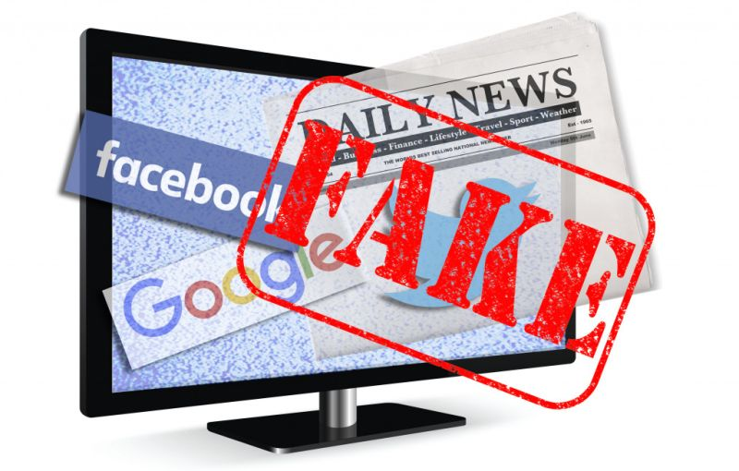
Fake News

Slide 2
Agenda
Propaganda Model
Fake News - Causes and Effects
Movies and Books for Students

Slide 3
Review
Fill in the blanks: 10/12 (1 each, 10 points total)
Short answers: 5/7 (3 each, 15 points total)
Scenario: ½ (5 points total)
Weight: 30%

Slide 4
Review cont.’d
Exam focuses on latter half of the course.
Section 2 of the Charter is on the exam.

Slide 5
Course Evaluation
Would it have been helpful to break the essay down into smaller parts? (e.g. a separate assignment to have you gather sources, find strong quotes, write an introduction, and finally submit it)
What could be done to encourage more student participation?
Do you wish more time was spent on review?
What was your favorite thing about class?
What was your least favorite thing about class?

Slide 6
Chomsky and Herman’s Propaganda Model
Edward S. Herman and Noam Chomsky wrote Manufacturing Consent in 1988. It saw the ‘free press’ of the United States as subject to corporate interests. These interests seek to promote capitalist propaganda through 5 filters.
Media ownership – mass media is expensive and overwhelmingly owned by corporate interests.
Advertising – consumers are unwilling to pay for the expenses of media and they are therefore reliant on advertising.
Complicity – reporters are encouraged to report the official consensus or have their access to those in power cut.
Flak – when people put out reports that corporate interests don’t like, they are able to lobby the broadcaster and disparage the reporter.
The Common enemy – when people are upset at the status quo, they are pointed towards an official enemy to direct their anger.

Slide 7
Has the internet changed the validity of this model?
Has it disrupted the importance of:
Media ownership?
Advertising?
Complicity?
Flak?
The Common enemy?

Slide 8
How has the internet shifted who has power over information?
Anyone can post anything.
We get much of our news from our friends, rather than governments or media corporations.

Slide 9
Fake News
Fake news is: “news articles that are intentionally and verifiably false, and could mislead readers” (Allcott & Gentzkow 2017, p.213).
This does not include (according to Allcott and Gentzkow):
Unintentional reporting mistakes
Rumors that do not originate from a particular news article
Conspiracy theories
Satire
False statements by politicians
Slanted or misleading news

Slide 10
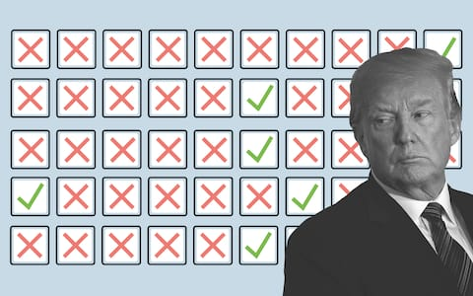
Social Costs of Fake News
Consumers who mistake fake news for real news have less accurate beliefs.
Less accurate beliefs cause social problems (e.g. democratic selection of inferior candidates).
Consumers become skeptical of legitimate news outlets.
Reduced demand for accuracy in reporting will reduce the incentive of news outlets to invest in accuracy.

Slide 11
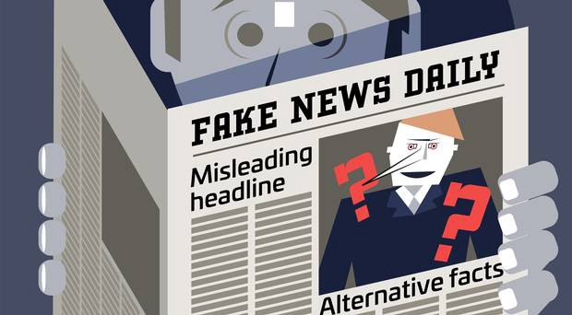
Causes of Fake News
Fake news is cheaper to provide than real news (no paying fact checkers, etc.).
The cost to produce news has gone down, allowing many to enter it.
Social media use has increased and is an ideal transmitter of fake news.
Consumers cannot costlessly infer the accuracy of fake news.
Consumers enjoy partisan news and increasingly enjoy putting down other political ideologies.

Slide 12
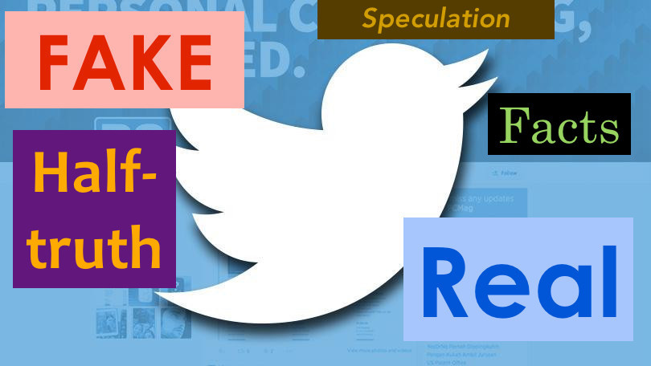
Social Media and Fake News
Social media platforms are conducive to fake news for several reasons:
The cost of creating content and putting it out there are minute.
The format of social media (small bit of information – often viewed on a phone) makes it harder to spot fakes.
Facebook friend networks are ideologically segregated (median share of friends with the opposite ideology is only 20% for liberals, 18% for conservatives).

Slide 13
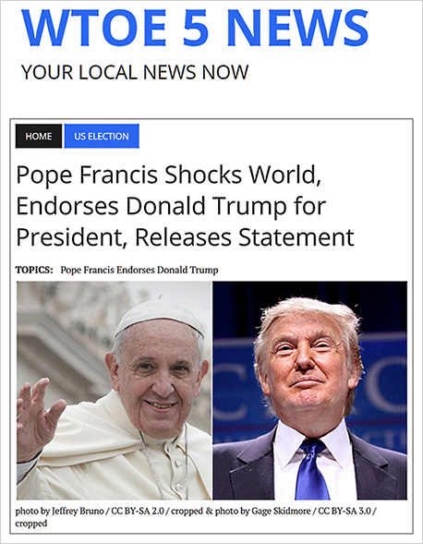
WTOE 5 has since been discontinued.
Most shared fake news story of the 2016 election. If fake news did have an impact on the election (which many, including Allcott and Gentzkow argue against), this was probably the most effective story.

Slide 14
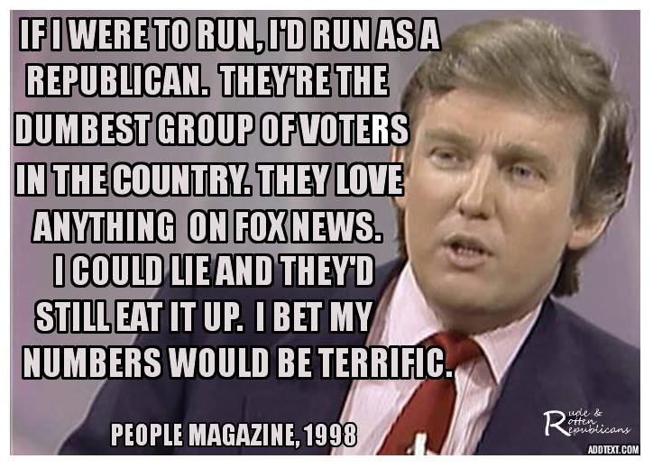
Democrats were not immune to fake news.
This (false) quote and photo were frequently shared amongst ideological liberals on Facebook.

Slide 15
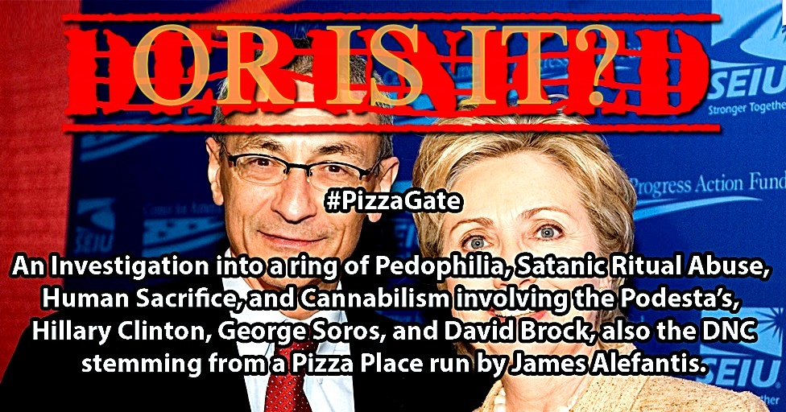
Truly Crazy Fake News

Slide 16
How do fake news and mental illness interact?

Slide 17
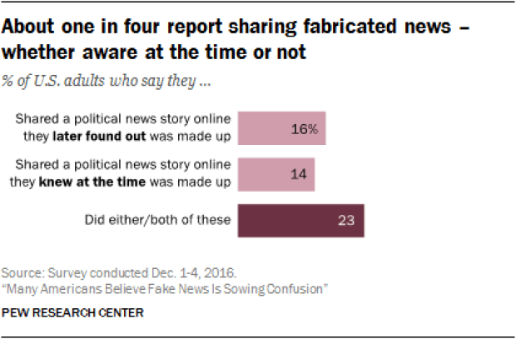
Current Trends in Fake News
62% of Americans get their news from social media.
The most popular fake news stories were shared on Facebook more often than the most popular mainstream news stories.
Many people who see fake news stories report that they believe them.
The most discussed stories tend to favor Donald Trump over Hillary Clinton.
- (Allcott and Gentzkow 2017).

Slide 18
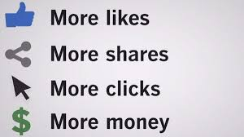
Motivations of Fake News
Money – having a news story go viral can earn purveyors of fake news a lot of money in advertising. For example, more than 100 news sites were run by teenagers in Macedonia trying to rack of views to make money.
Ideology – people knowingly spread fake news in order to back their own ideological supporters at the expense of political opponents.

Slide 19
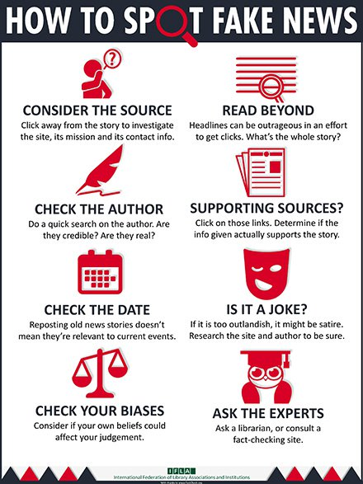
What can be done?
“In theory, a social planner should want to address the market failures that lead to distortions, which would take the form of increasing information about the state of the world and increasing incentives for news consumers to infer the true state of the world” (Allcott & Gentzkow 2017, p. 232).
Being less ideologically inclined made readers more likely to see through false stories – as did education.

Slide 20
TV and Movies for Students
The Wire (HBO 2002-2008): Best show ever. Police drama that follows both cops and criminals set in Baltimore.
Malcolm X
Fight Club
Persepolis: Cartoon Movie about a woman growing up in Iran.
V for Vendetta: Set in a dystopian world, a fun revenge-movie about a revolution that overthrows an authoritarian regime.
The Corporation (documentary – available on YouTube)
Roots (story of slavery, told over several generations)
Atlanta (FX 2016-present): Donald Glover’s show about managing a rap career in Atlanta. It has lots of nuance and willing to experiment with style.
Shawshank Redemption
Rick and Morty (Adult Swim): Cartoon with lots of incredible, high concept Sci-Fi.
Moonlight (2016 triple Oscar winner): Race and Sexuality
Waking Life (Animated movie that does a quick overview of many philosophical theories of life and death).
Little Miss Sunshine
Crash (Racism and Racial Bias in America)
Honorable Mention: The Truman Show/Into the Wild -> both on lots of lists of ‘lifechanging movies’.

Slide 21
Books for Students
Siddhartha: Very short and easy to read. Gives you an idea of the basics of Buddhism.
Ishmael: Human supremacy as a cultural myth.
Animal Farm: George Orwell’s classic novella about authoritarianism and both the need for and dangers of revolutions.
Persepolis: the comic of the movie mentioned above, by Marjane Satrapi.
Autobiography of Malcolm X
Crime and Punishment: Dostoyevsky’s psychological thriller about murder and ethics.
Grapes of Wrath. John Steinbeck’s novel of a family’s journey to California in search of work.
Civil Disobedience. Book by Henry David Thoreau, written when he went to prison for refusing to pay taxes to fund the Mexican-American War.

